Slide 1


Slide 2
INTERNSHIP PROJECT REPORT
FROM
VIGO TECHNOWORLD PVT. LTD.

Slide 3
MADE BY- VINEET MISHRA MASTER OF BUSINESS ADMINISTRATION BUSINESS ANALYTICS
SUBMITTED TO –
MS. SRISHTI KHAMPARIYA
GYAN GANGA INSTITUTE OF TECHNOLOGY AND SCIENCE

Slide 4
Introduction
• The development and use of renewable energy resource is on the rise today. Many new companies are stepping into the field of solar energy and installment of solar appliances.
• But in today's competitive world, these businesses need something more than just traditional business process.
• These businesses need to go a step ahead and invest in processes that can successfully develop new business strategies and suggest ways to implement them.
• One such process is Business Analytics, which helps business grow by analyzing their data and taking actions accordingly.

Slide 5
SOFTWARE USED-
• Throughout my internship I was required to know the use and implementation of a number of software and tools like:
• Microsoft Excel
• Power BI
• Postgre SQL

Slide 6
Software for Particular Work
• I used several tools throughout the analysis process
• Microsoft Excel: This tool was used for storing the company's data and sharing the data with concerned bodies.
• Jamovi Statistical Tool: This tool was used for standardizing the data.
• Jupyter Notebook: This was the main tool that I used for carrying out the whole analysis process, all the Data Cleaning, Exploratory Data Analysis, and Data Visualization was done in this tool.
• Postgre SQL: This tool was used to create different tables according to clients demand.

Slide 7
Description
• I was hired for the role of Data Analyst and throughout my internship I worked on these projects.
• Presentation on State Solar Policies: I was required to gather data related to Solar Policies of States of India and create a presentation for the same.
• Analysis of Telemarketing and Sales Data: For this project, the company provided us with their Telemarketing and Sales Data which we had to analyze, extract information, and create a presentation on how their Telemarketing and Sales teams were performing and suggest new ways to conduct Telemarketing campaigns.
• Analysis of Customer Data: This was our final project and we were given a dataset containing Customer Data of the company and we were required to analyze it and figure out the states in which the company should invest for increasing sales and attracting more customers

Slide 8
Working as an Intern
This was my first internship as a Data Analyst and it was quite an experience for me to explore this field and get an experience of working in a company.
• We were exposed to the company's working force and structure and we were given real project that impacted the company's working.
• The internship was converted to a Work From Home but the our HR Head was very supportive throughout the internship period.
• As an Intern my experience as a Data Analyst for the company was quite good and I learned new skills that were required to perform the analysis in a very less time.

Slide 9
Activities
The activities that were conducted throughout the internship process were-
1. Assignment of projects and tasks
2. Weekly report submission
3. Weekly meetings for doubts and queries
4. Submission of tasks
5. Evaluation of submitted work

Slide 10
Day to Day Activities
• My day would start with understanding the task and creating a plan for the day
• Then I used to conduct some research work related to the task
• After that I would start doing my analysis task along with documenting each step and process
• After completing the task, I used to clean up my code and make it more readable
• And then I used to work on creating the presentation with the results I found during the analysis process
• Once these steps were completed, I used to write the tasks for the next day in advance

Slide 11
Conclusion
I conclude that for this internship as a Data Analyst, the knowledge of tools and software proved to be beneficial for the tasks that were assigned to me and the results I delivered were well appreciated.
• It was a great time interning for this renewable energy company and I'm glad I was able to deliver results and submit my reports on time.
• I have become more skilled and acquired business acumen after interning for the company.

Slide 12
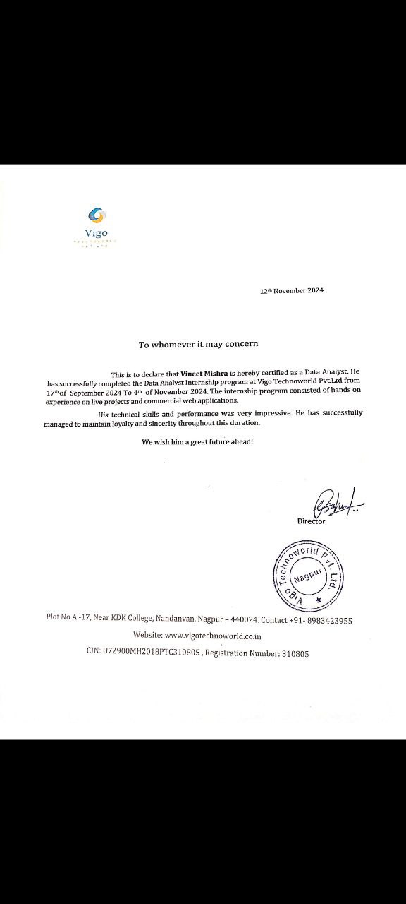

Slide 13
END

